Slide 1
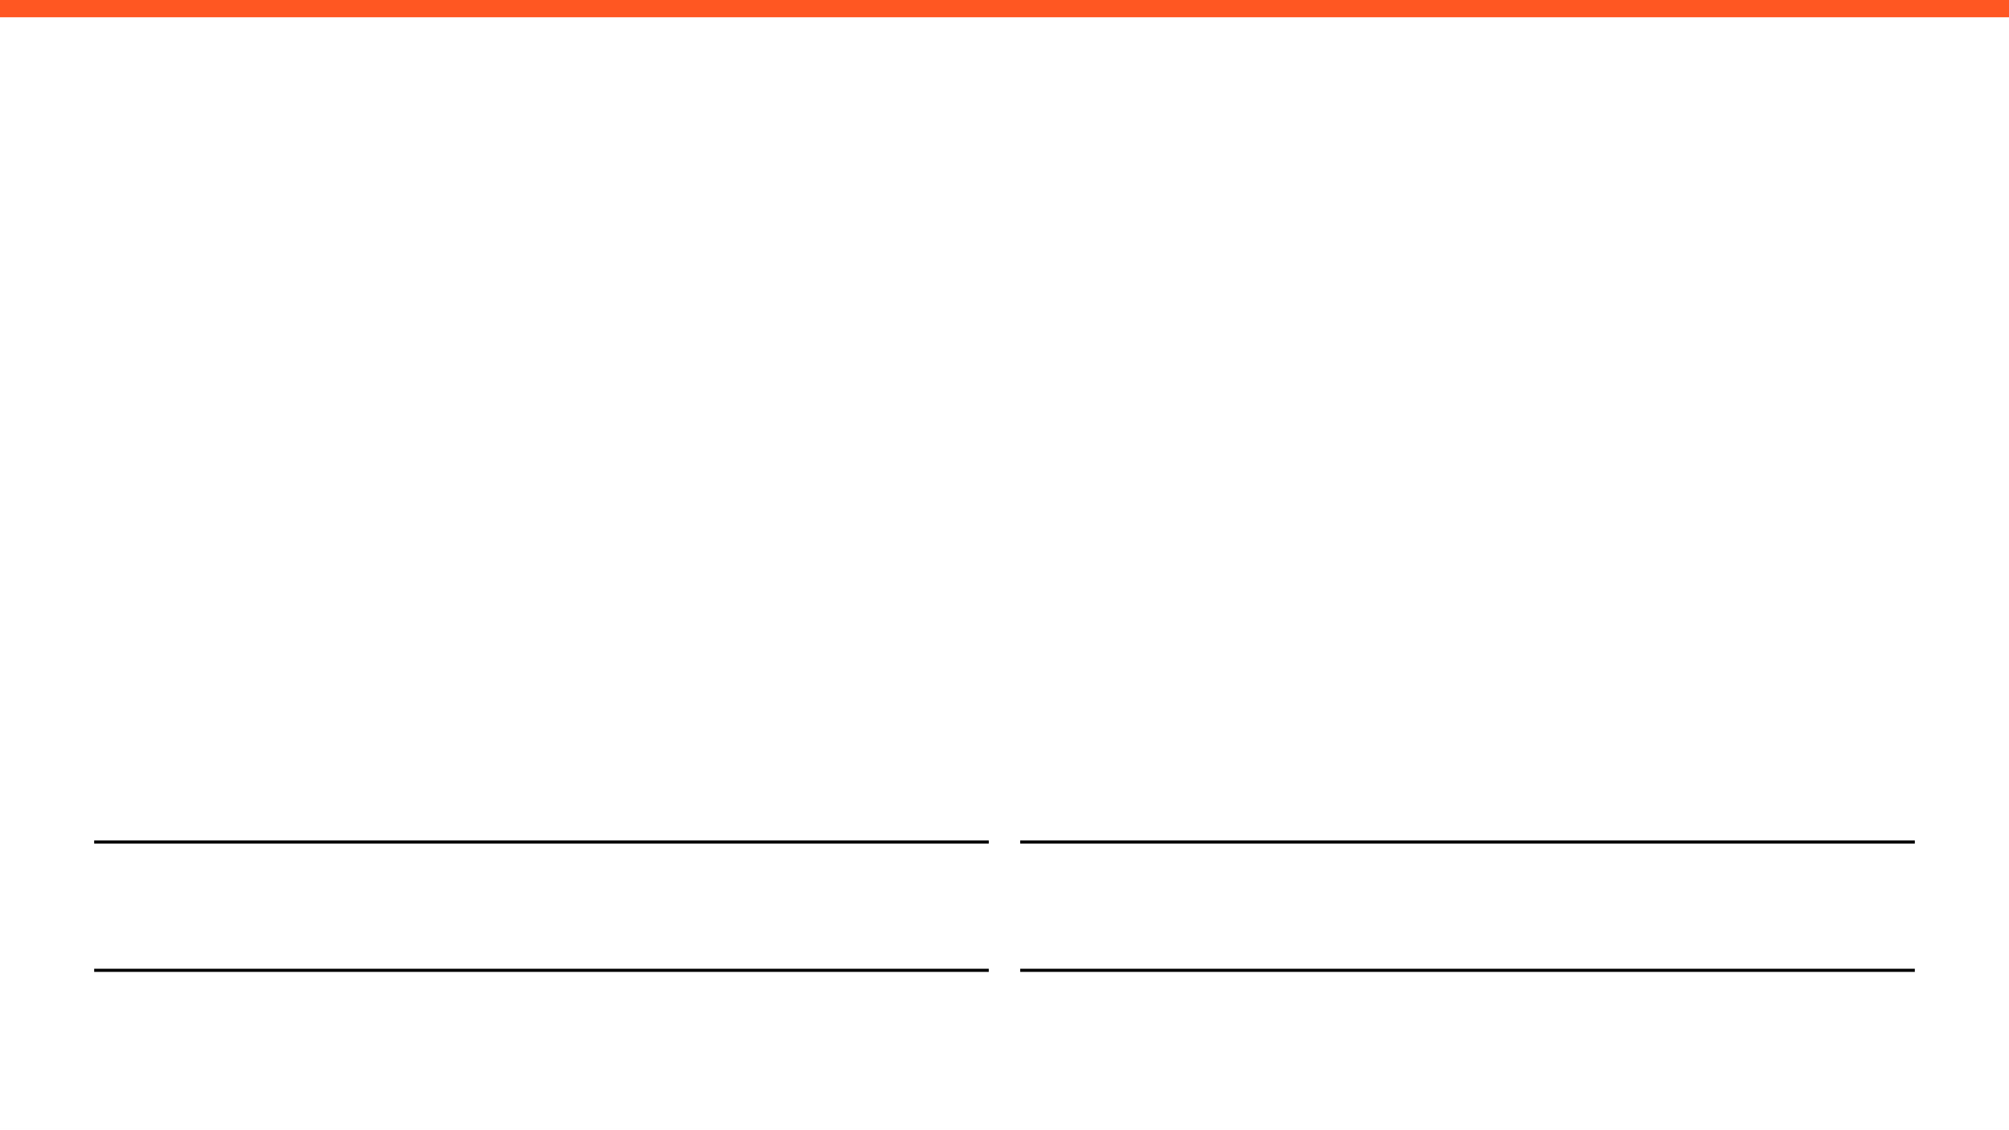
WEEKLY PROGRESS REPORT
Mechatronic System Design (MEC483) – Course Project
PROJECT / PHASE
DATE RANGE
Smart Pick and Place Robot / Phase 2
3/3/2026 – 10/3/2026
TEAM MEMBERS
Maher Abo Abed (1087993) , Sabeeha Zainab Hasham (1089042), Basel Feras Ghunaim (1088912), Ahmad Nasser Alshehhi (1090882)

Slide 2

HOW ARE WE DOING THIS WEEK?
TOP WINS (MAX 3)
KEY BLOCKERS / RISKS (MAX 3)
PROJECT HEALTH
Win 1: Made decisions on some major components (Computer vision, electrical actuators, displacement sensors) of the system through a systematic and objective procedure.
•
•
Blocker 1: No access to the university facility due to the ongoing regional situation ; access is needed to 3D print parts and begin with testing and prototyping.
Scope
Under Execution
Schedule
Potential Delays
Blocker 2: Uncertainty around university campus operation status and course delivery method has hindered communications and work progress.
Win 2: Tested popular computer vision pretrained models to check for their computability such YOLOv3 andYOLOv4 through MATLABs Computer Vision and Deep Learning Toolboxes, along with the laptop’s built-in camera.
•
•
Fabrication & Prototyping
On Halt
Win 3: Explored the potential use of the AccelStepper library to simplify stepper motor control and improve motion smoothness, as it can handle acceleration and deceleration profiles, timing of step pulses, internal software-based step counting, and non-blocking control for multiple motors.
OPEN ISSUES
•
3 Active

Slide 3

Project Schedule (Gantt)
Task / Phase
W1
W2
W3
W4
W5
W6
W7
W8
W9
W10
W11
W12
System Definition and Primary Sensing
Singal Conditioning and Conversion
Digital Logic and Data Presentation
Fluid Power and Kinematic Chain
Electrical Actuation and Motor Selection
Embedded Controller Selection
Firmware Development
I/O Interfacing and Industrial Control
Communication and Networking
Mathematical System Modelling
Stability and Feedback Control
Intelligent Control and Final Design

Slide 4
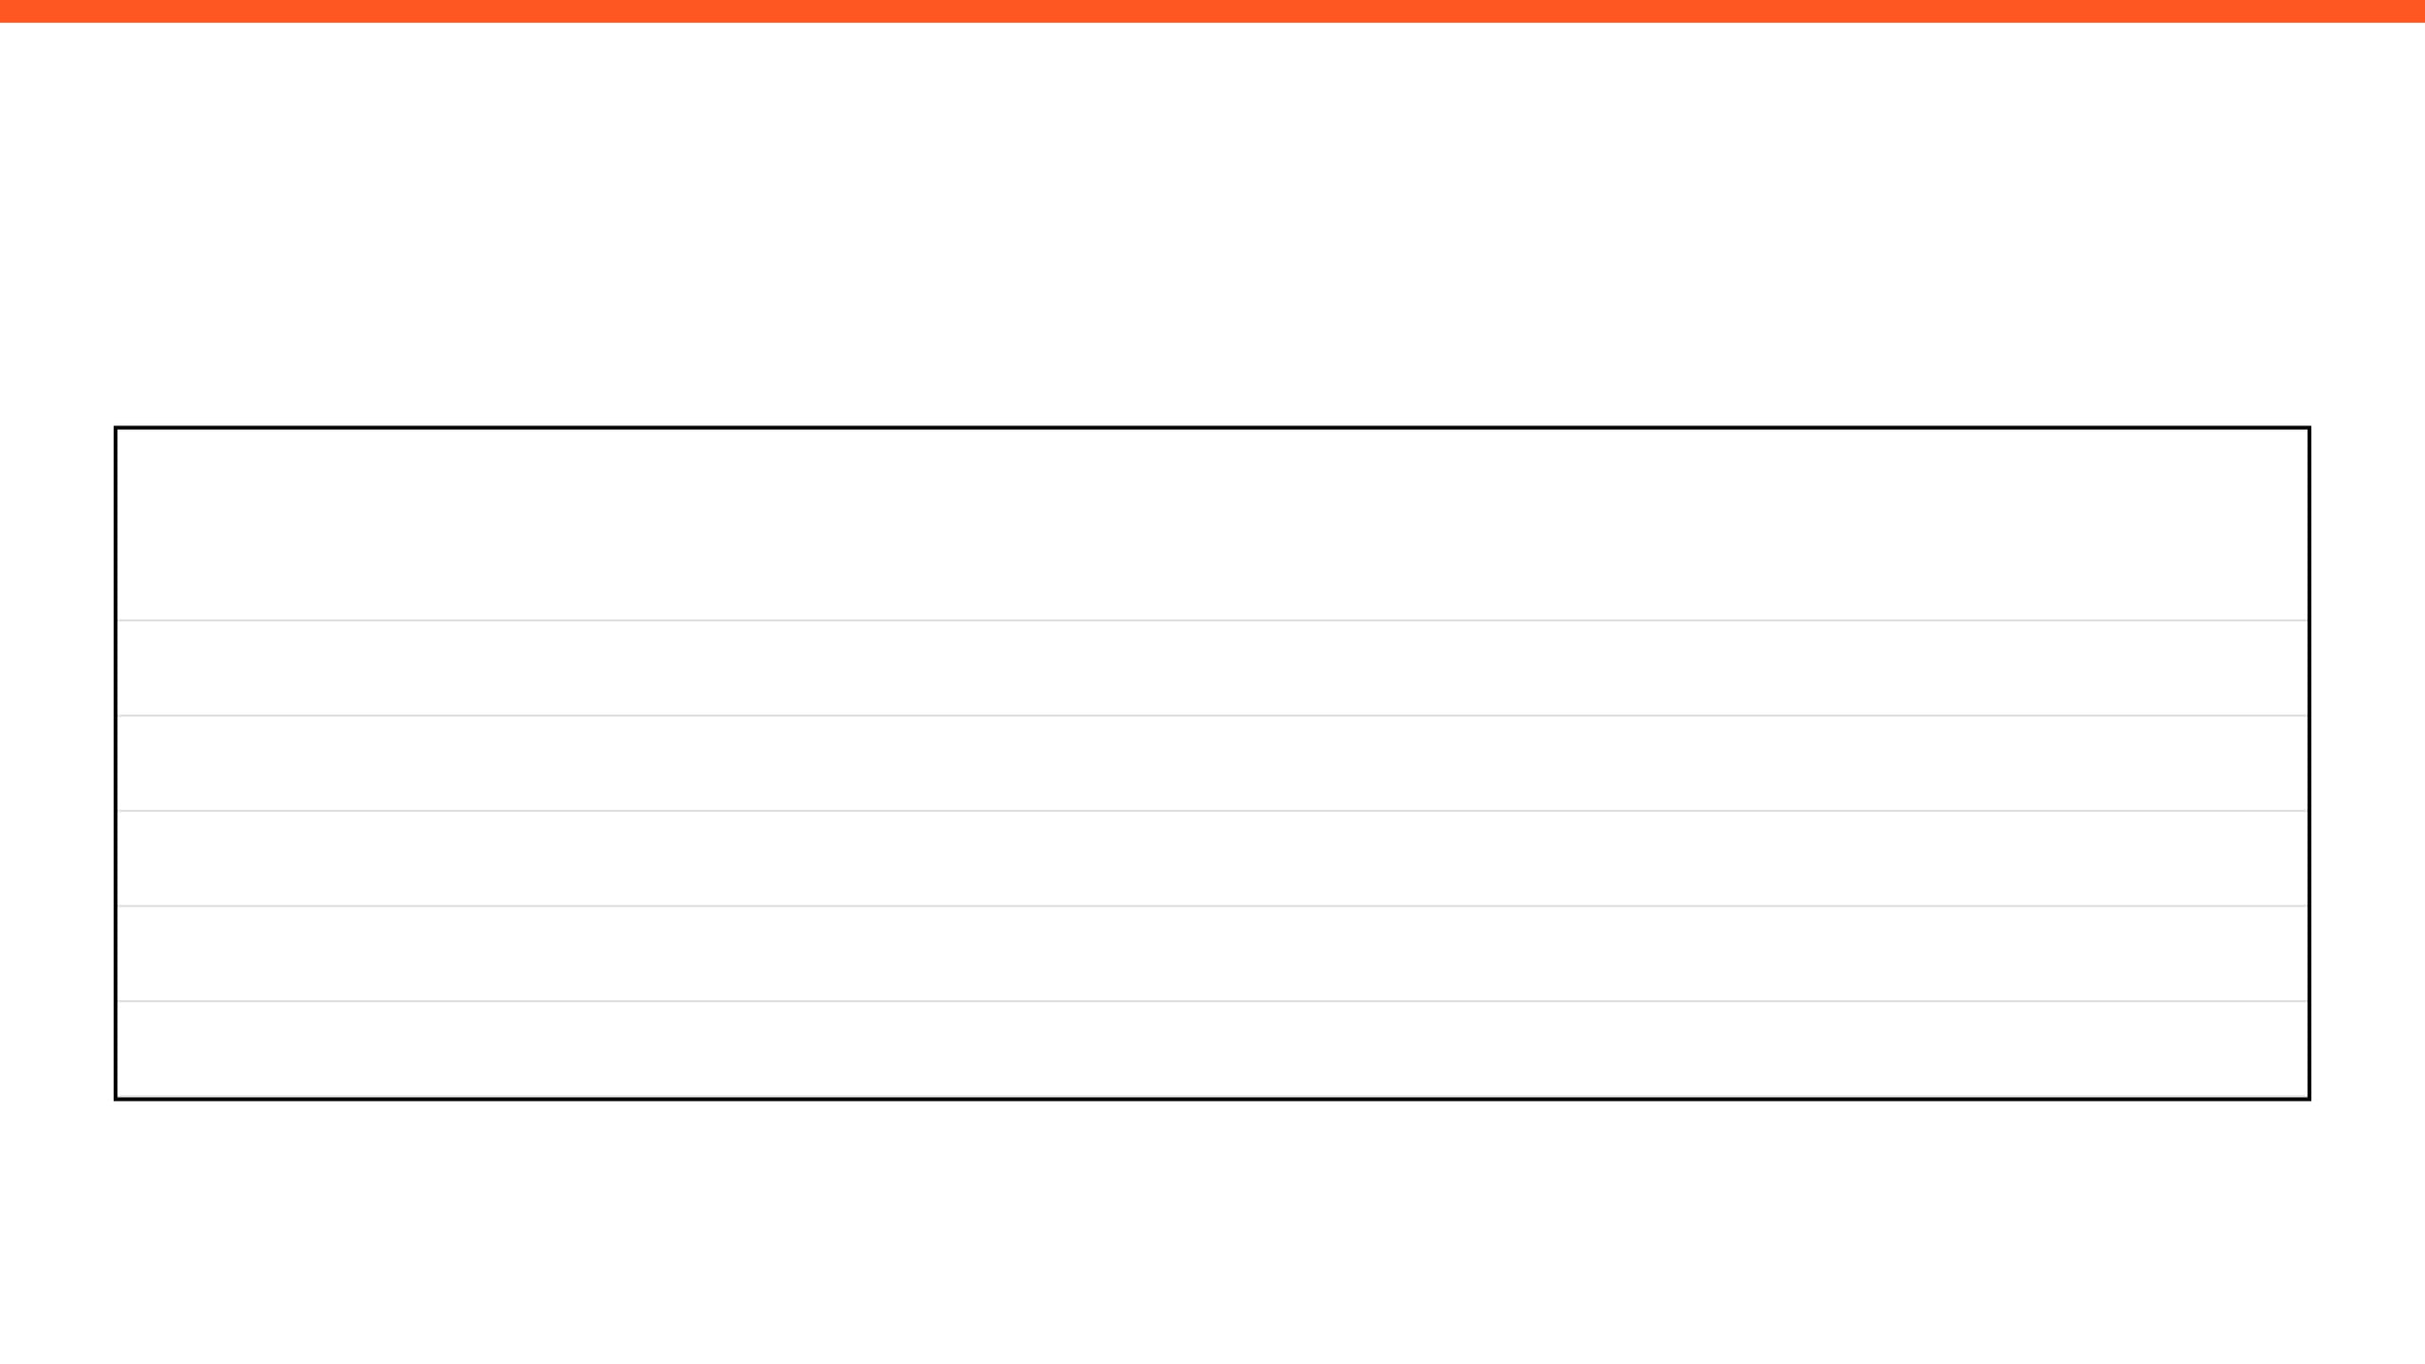

MILESTONES & DELIVERABLES

Slide 5
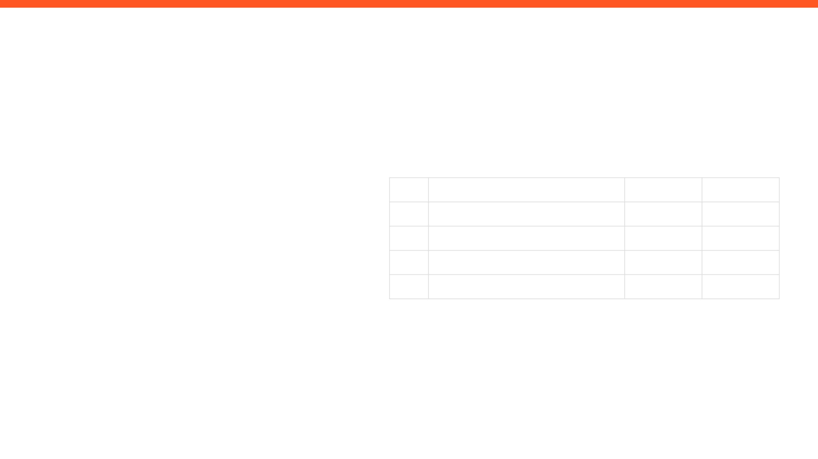
ISSUES, RISKS, AND ACTION ITEMS
TOP ISSUES (BLOCKING PROGRESS)
ACTION ITEMS (NEXT 7 DAYS)
•
Being limited to solely software-based work, ie: research/computer vision can slow
down performance – not having easy access to facilities to make the model, ie: 3D
printer.
ID
ACTION ITEM DESCRIPTION
MEMBER
WEEK DUE
A1
Design a useable end effector and complete the pump selection
Sabeeha
Week 4
•
Due to current circumstances, teammates cannot meet in person to discuss project
planning, this has resulted in Microsoft Teams meetings occurring 1-2 times a week.
This can be limiting as only one teammate has access to the objects that need to be
picked up by the arm.
Exploring computer vision models and develop a model that can be used to test on
A2
Maher
Week 4
A3
Investigate motion control strategy, torque estimations, suction system and gripper
Basel
Week 4
MITIGATIONS / DECISIONS NEEDED
A4
Finalise sensor selection and integration in system
Ahmad
Week 4
Focus on aspects that can be conducted without the need for printing the model
– design/computer vision/research
•
More comprehensive meetings are required to mitigate this issue,
planning in advance and strong delegation of tasks needs to be implemented.
•

Slide 6

INDIVIDUAL UPDATES
WEEKLY PROGRESS & NEXT STEPS
MEMBER 1
MEMBER 2
Maher Abo Abed
Sabeeha Zainab Hasham
MEMBER 3
MEMBER 4
Basel Feras Ghunaim
Ahmad Nasser Alshehhi

Slide 7
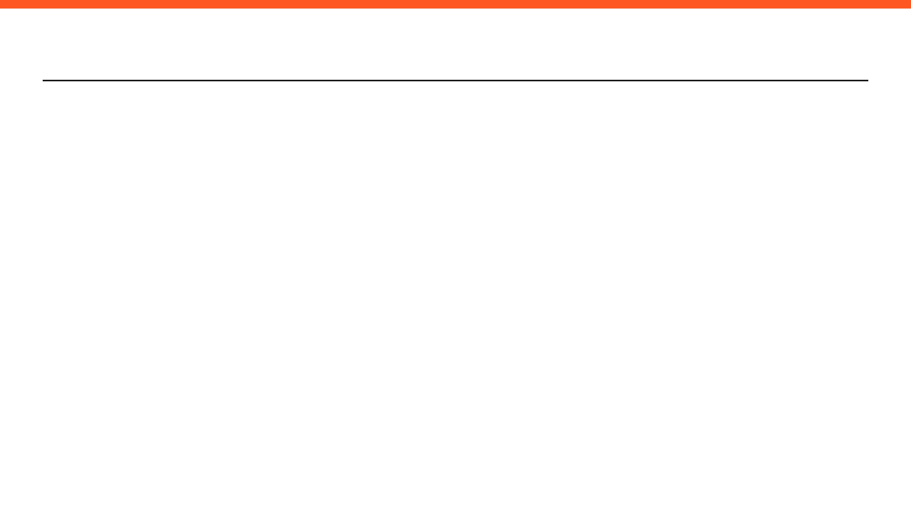
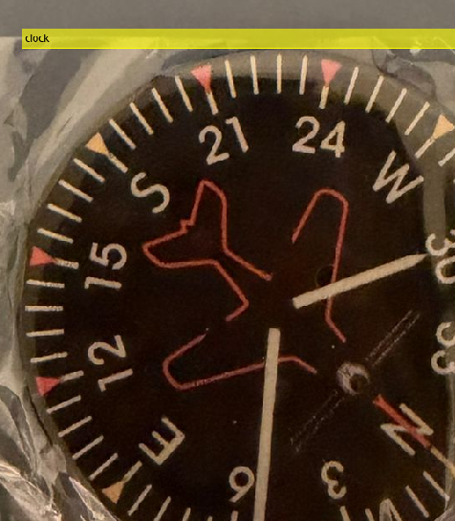
MEMBER 1: Maher Abo Abed
ACCOMPLISHED (SINCE LAST REPORT)
EVIDENCE
Tested computer vision models such as YOLOv3, YOLOv4 through MATLABs Toolboxes.
•
Explored the need and the types of angular displacement sensors that can be used and their sub-types.
•
Identified optical incremental encoder as feasible option.
•
[ VISUAL EVIDENCE AREA ]
IN PROGRESS
(Insert Screenshot, CAD View, or Data Plot)
Develop a model that can be used for testing and familiarization of the different sub-systems and components..
•
Exploring various computer vision models that can be used, as an alternative to training an AI model from scratch.
•
NEXT WEEK PLAN
Finalize selection of most components through an objective evaluation.
•
Make significant progress on a CAD model for a testing prototype. .
HELP NEEDED / QUESTIONS
•
Is access to university equipment and facility possible throughout the break?
•
Can a reliable system be constructed without the use of angular displacement sensors such as encoders?
•

Slide 8
MEMBER 2: Sabeeha Hasham
ACCOMPLISHED (SINCE LAST REPORT)
EVIDENCE (SHOW, DON'T TELL)
Comprehensive motor selection and analysis using PCC method, 3 options investigated in 6 categories
– weighted decision matrices
Defined the criteria required for the pump selection and initiated an analysis
Started looking at potential end effectors – potentially to use a rack and pinion and servo motor
•
•
Progress report consisting of already conducted research is attached to this slide.
https://studentsaduac-my.sharepoint.com/:w:/g/personal/1089042_students_adu_ac_ae/IQARBpffIjuvTpyWARClVW9bAea6LwJ429ddhBODEQaYlCs?e=AGMXr2
IN PROGRESS
Completion of pump selection - in progress
Completion of the end effector design to be completed
•
•
NEXT WEEK PLAN
Research and on computer vision – potential trial runs.
•
HELP NEEDED / QUESTIONS
•
•

Slide 9
MEMBER 3: Basel Feras Ghunaim
ACCOMPLISHED (SINCE LAST REPORT)
IN PROGRESS
Established a position sensing system using homing limit switches and stepper motor step counting.
Considered the necessity of a velocity sensor and ensured that velocity could be calculated in software.
Design and documentation of the vacuum suction system to handle CDs, calculation of holding force and component selection.
Evaluated encoder feedback as optional improvement to better positioning reliability.
Added gear and belt transmission ratios to calculations of joint positions.
Last comparison of motion control implementation software (AccelStepper library vs home written step pulse generating).
Determining the need or not of encoder feedback, according to anticipated mechanical load and possible step loss.
Optimizing the incorporation of the hybrid end-effector design (mechanical fingers + suction cup).
Revising the effect of gear backlash and belt elasticity on positioning error.
•
•
•
•
•
•
•
•
•
Evidence:
stteper motor and encoder.docx
Mechatronics System Design week one.docx
Vacuum Suction System.docx
NEXT WEEK PLAN
HELP NEEDED / QUESTIONS
Make decision on motion control strategy final and start implementation.
If encoder feedback is used, begin basic planning for PID control.
Perform torque estimations based on transmission ratios and loading circumstances.
Begin mechanical layout planning of the installation of the suction system in the gripper assembly.
•
Clarification on whether rotary encoders are strictly required for this project, or if open-loop stepper control with homing limit switches is sufficient.
Confirmation on the acceptable level of positioning accuracy expected for grading purposes.
Guidance on whether encoder-based closed-loop feedback is recommended given the current mechanical design (gear and belt transmission).
•
•
•
•
•
•

Slide 10
MEMBER 4: Ahmed Alshehhi
ACCOMPLISHED (SINCE LAST REPORT)
IN PROGRESS
Researched and identified the required sensors for the pick-and-place robot system.
•
Assisting in defining the sensor integration architecture for the robotic system.
•
•
Evaluated different sensor options and prepared a list of recommended sensors with their
purposes and approximate costs.
Evidence : Sensor specification list and preliminary components comparison for decision matrix.
NEXT WEEK PLAN
HELP NEEDED / QUESTIONS
Finalize the sensors selection based on the decision matrix results.
•
Clarification on the final testing parameters for the robotic systems.
•
Assist in integrating the selected sensors into the initial system design and CAD model.
•

Slide 11
WRAP-UP: WHAT WE NEED FROM THE INSTRUCTOR / STAKEHOLDERS
DECISIONS REQUESTED
ACTION ITEMS FOLLOW-UP
Access to university laboratories for 3D printing the required components and models.
•
Begin working on the initial CAD design draft.
•
Design, build, and test a small-scale prototype before developing the final system.
•
QUESTIONS / FEEDBACK
When will we have access to the university labs for fabrication and testing?
•
APPENDIX
Sensor specification sheets.
•
What are the testing parameters and evaluation criteria for the prototype?
•
MATLAB Computer Vision Code
•

